Slide 1

DAYANANDA SAGAR COLLEGE OF ENGINEERING Department of Medical Electronics Engineering
Academic year 2024-2025
MINI-PROJECT I (22MD49) OPENDAY 2025
ELDERLY CARE: DEVELOPMENT OF GERIATRIC WELLNESS INDEX
 |  | Student Name | USN
 |  | Tvisha Ranganath | 1DS23MD056
 |  | Manushree V | 1DS23MD017
 |  | Shreya M | 1DS23MD042
 |  | TGM Sumanth | 1DS23MD052
Under the guidance of
Supervisor: Dr. Sriraam N
Dean R&D Professor And HOD of MD, DSCE
Co-supervisor: Dr. Geetha N K
Professor, Mathematics, DSCE

Slide 2
INSTITUTE VISION
To impart quality technical education with a focus on research and innovation, emphasizing on development of sustainable and inclusive technology for the benefit of society
INSTITUTE MISSION
To provide an environment that enhances creativity and innovation in pursuit of excellence To nurture teamwork in order to transform individuals as responsible leaders and entrepreneurs To train the students to the changing technical scenario and make them to understand the importance of sustainable and inclusive technologies

Slide 3
DEPARTMENT VISION
To develop an excellent center of progressive quality learning, applied & translational research through inventive collaborations and sustainable solutions to address healthcare related societal challenges
DEPARTMENT MISSION
By creating a conducive atmosphere for continuous learning through increased participation of students and faculty in various academic activities By achieving needful and relevant healthcare solutions through quality education and research By imparting education in the path of ethical and social responsibilities, to work effectively with diverse groups for the benefits of the society

Slide 4
PROGRAMME EDUCATION OBJECTIVES (PEOs)
Graduates will be able to:
PEO1 | Apply knowledge of Medical Electronics to excel in their profession
PEO2 | Practice Engineering to analyze problems and find solutions in allied domains using multidisciplinary approach
PEO3 | Disseminate professional skills for ethical and societal responsibilities
PEO4 | Engage in lifelong learning and contribute in the field of engineering research

Slide 5
Contents
Introduction
Problem Definition
Literature review
Objectives
Components
Proposed Methodology
Expected Outcome
Project Schedule-Gantt Chart
Work done so far
Results and discussions
Conclusion
References

Slide 6
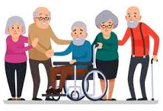
INTRODUCTION
Geriatric care is a medical specialty that focuses on the health of the older adults.
As the global population ages, the need for effective elderly care has become increasingly vital. The well-being of senior citizens, especially in terms of cognitive and physical health, is a primary concern.
In this context, the Geriatric Wellness Index (GWI) serves as a comprehensive tool to assess and monitor the health of elderly individuals, helping healthcare providers understand the overall wellness of their patients.
Our project focuses on surveying elderly individuals using parameters such as Actofit (a wearable fitness tracker), Blood Pressure, and ECG readings. Additionally, we integrate audio and video data to ask specific questions that will help in assessing cognitive stability.
The aim is to assist clinicians in identifying cognitively stable and cognitively unstable individuals, allowing for timely intervention and better-targeted care.
Fig1
https://encrypted-tbn0.gstatic.com/images?q=tbn:ANd9GcSvYmC5BL1nRa8RCu15BiyHRKU5XPbvkGZ4Ig&s

Slide 7
PROBLEM DEFINITION
The elderly population faces significant physical and cognitive health challenges, but current monitoring methods often fail to integrate real-time physiological and cognitive assessments. This leads to delayed diagnoses of cognitive decline and inadequate care.
Our project aims to bridge this gap by using the Geriatric Wellness Index (GWI) to combine data from wearable devices (like Actofit, blood pressure, and ECG) with cognitive evaluations through audio and video, helping clinicians identify cognitively stable and unstable individuals for better-targeted care and early intervention.

Slide 8
LITERATURE REVIEW
SN | Author | Topic/Publication/Year | Inference
1. | Lu Yang | Construction of Integrated Health Care and Elderly Care Talent Training System for Health Care and Elderly Care Major in Higher Vocational Education under Combination of Medical Treatment and Endowment IEEE, December 2020 | The integration of health care and elderly care knowledge is crucial for talent development in medical and nursing institutions. Research suggests creating a training system to cultivate comprehensive talents to support industry growth.
2. | Anand Krishnan, John Sligh, Eric Tinsley, Jean Bandos | Causal Association Mining from Geriatric Literature IEEE, November 2014 | This study uses natural language processing and statistical methods to extract causal relationships from geriatric care literature, achieving 79.54% precision and 81% recall. It aims to translate research into practice more efficiently.
3. | Mandeep Sekhon, Martin Cartwright, Jill J. Francis | Development of a theory-informed questionnaire to assess the acceptability of healthcare interventions IEEE, March 2022 | This study develops two intervention-specific acceptability questionnaires based on the Theoretical Framework of Acceptability (TFA), offering a brief, adaptable tool for measuring intervention acceptability across healthcare interventions.

Slide 9
LITERATURE REVIEW
SN | Author | Topic/Publication/Year | Inference
4. | Prasanta K Bhattacharya, Kuldeep Deka, Bhupen Barman | Validity and Test-retest Reliability of perceived Wellness Survey among Geriatric Population: A Community PubMed, March 2023 | The Perceived Wellness Survey (PWS) effectively assesses the psychosocial, physical, and intellectual well-being of elderly individuals, demonstrating strong validity and high test-retest reliability, except for the physical subscale.
5. | Mandeep Sekhon, Martin Cartwright, Jill J. Francis | Test–retest Reliability of Perceived Wellness Survey among Community-dwelling Geriatric Population: An Observational Study Research Gate, November 2024 | Demonstrates excellent test-retest reliability and internal consistency, making it a reliable tool for assessing wellness in the geriatric population.

Slide 10
OBJECTIVES
To evaluate physical, mental, emotional, and social health dimensions in elderly individuals.
To assess the ability of elderly individuals to perform Activities of Daily Living (ADLs) and Instrumental Activities of Daily Living (IADLs).
Data collection to determine the health condition by using devices such as Actofit , Polar H10, Blood Pressure.
To evaluate the data, we use the statistical model- Generalized Linear Model (GLM).

Slide 11
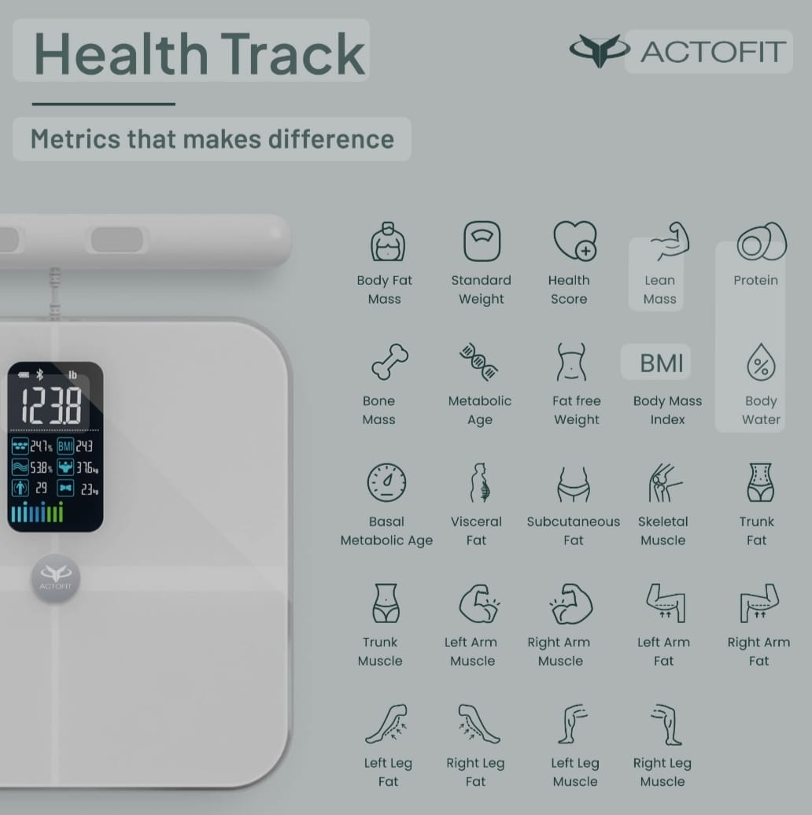
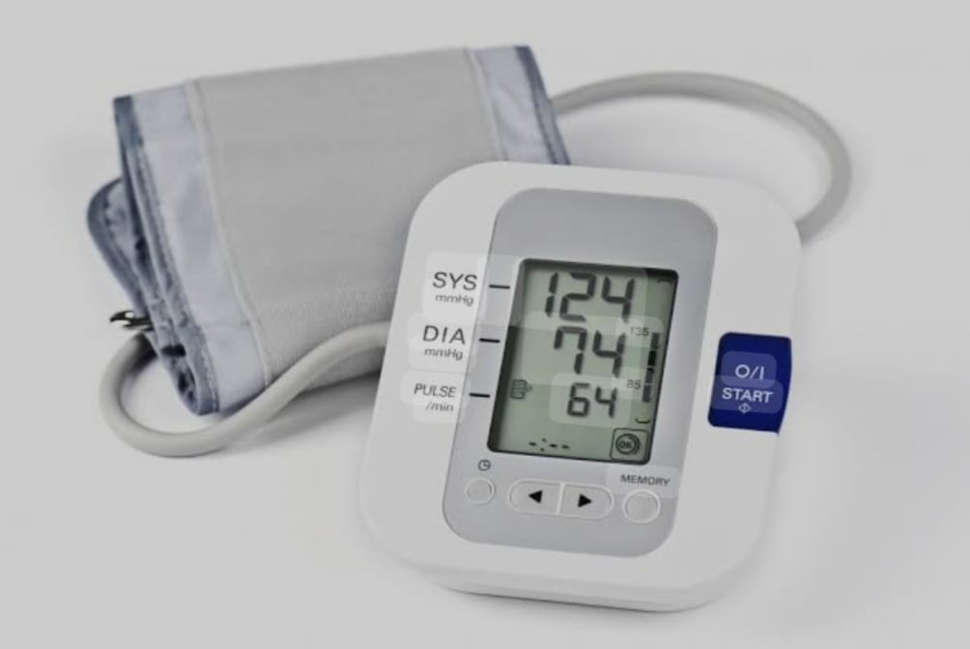
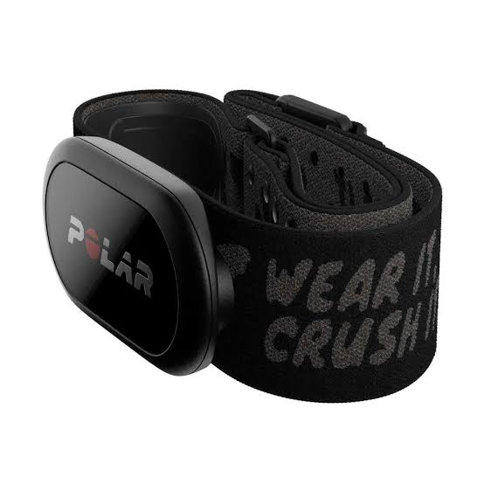
COMPONENTS
Fig2
Hardware Components
ACTOFIT
Weight
Body Fat
Muscle Mass
BMI
Bone Mass
Visceral Fat
Body Water
Subcutaneous Fat
Fat Free Weight
Physique
https://images.app.goo.gl/LLuPiQJkFJJHT9X97
Fig3
BLOOD PRESSURE
Systolic Pressure
Diastolic Pressure
ECG
Signals of the heart in Wave Form
https://images.app.goo.gl/kMZBJ89pgj4SgQAd8
Fig4
https://images.app.goo.gl/H7wYV

Slide 12



Software component
Fig5
Google Colab - Python
Google colab-python
Actofit-smart scale
ECG-analysis for polar H10
Fig6
ECG Analysis for Polar H10
Fig7
Fitdays- Actofit

Slide 13
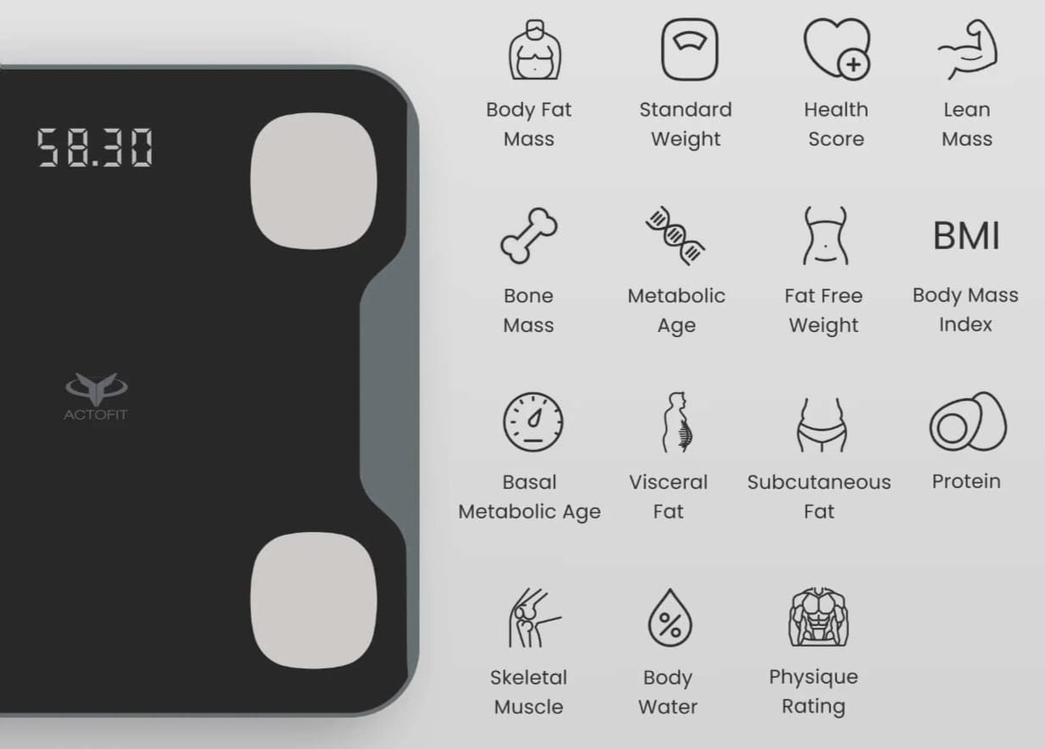
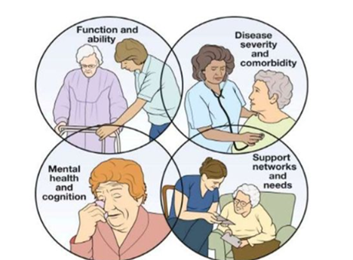
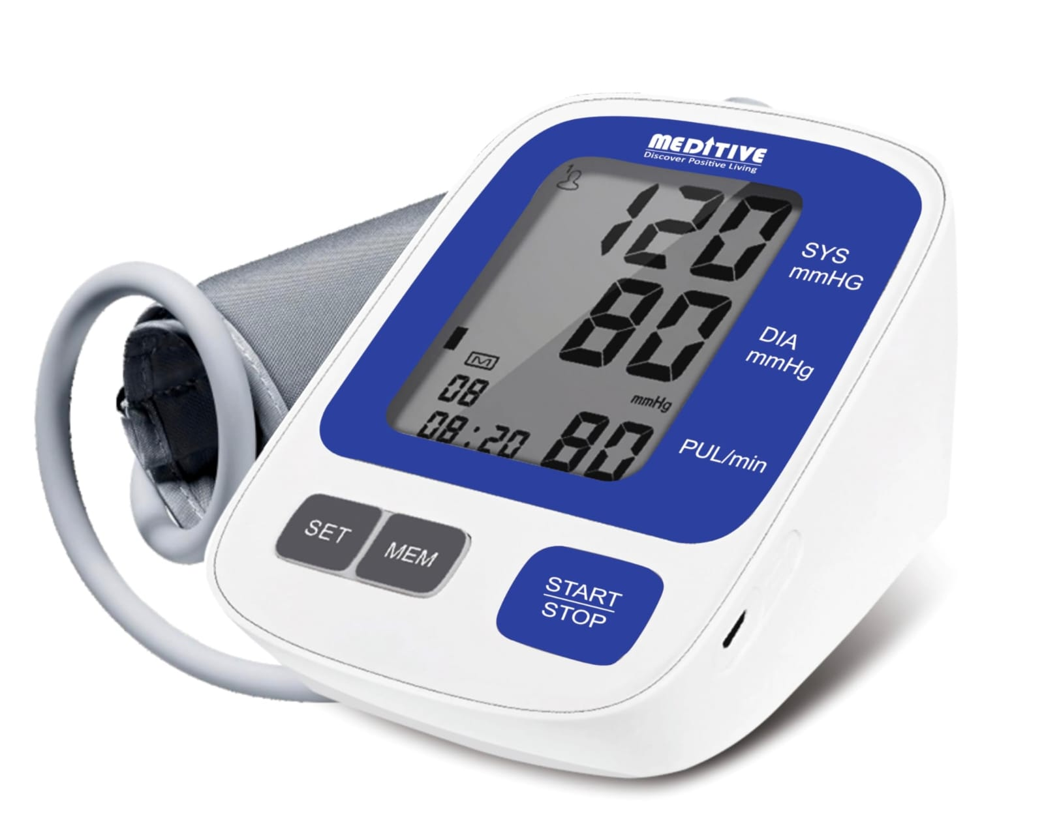
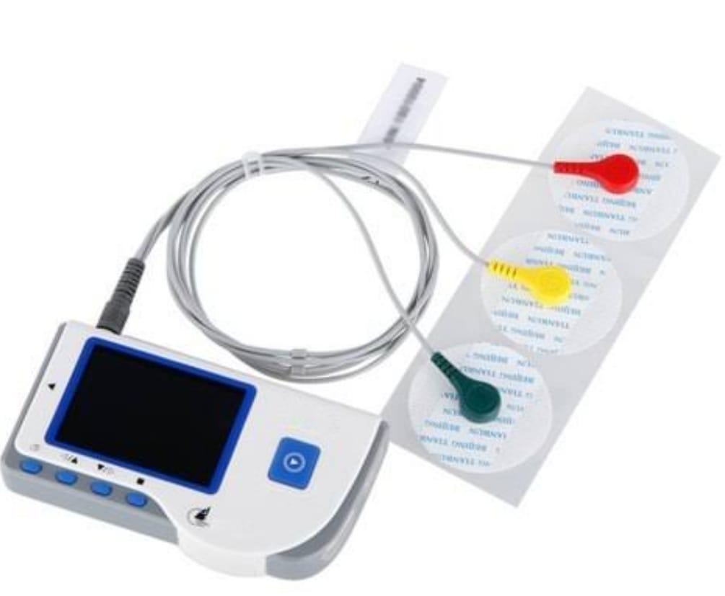


PROPOSED METHODOLOGY
ACTOFIT
CLINICAL
ASSESMENT
Statistical
model
GWI
BLOOD PRESSURE
Cognitive stable
AUDIO
VIDEO
ECG
Pattern
classifier
Cognitive unstable
Pre-processing and feature extraction

Slide 14
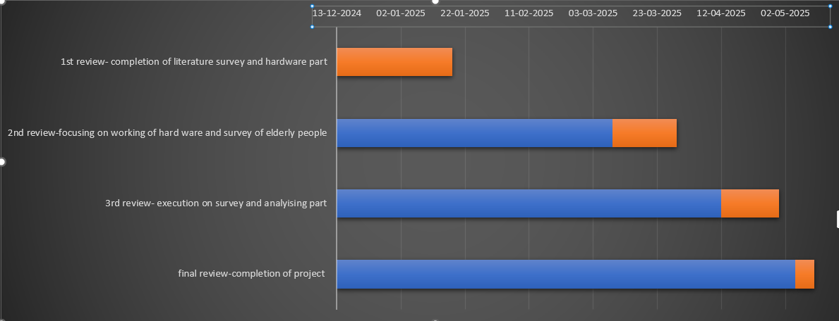
PROJECT SCHEDULE -GANTT CHART

Slide 15
EXPECTED OUTCOME
It will help classify elderly individuals into cognitively stable and cognitively unstable categories based on collected data, aiding clinicians in identifying those at risk of cognitive decline.
Enhanced care planning and resource allocation for at-risk elderly people.
Geriatric Wellness Index (GWI): A comprehensive index that combines physiological and cognitive data for real-time elderly health monitoring.
Using statistical model- Generalized Linear Model (GLM)
A flexible framework for modeling a wide range of data types by extending linear regression. GLMs are commonly used for data that don't meet the assumptions of ordinary linear regression.

Slide 16
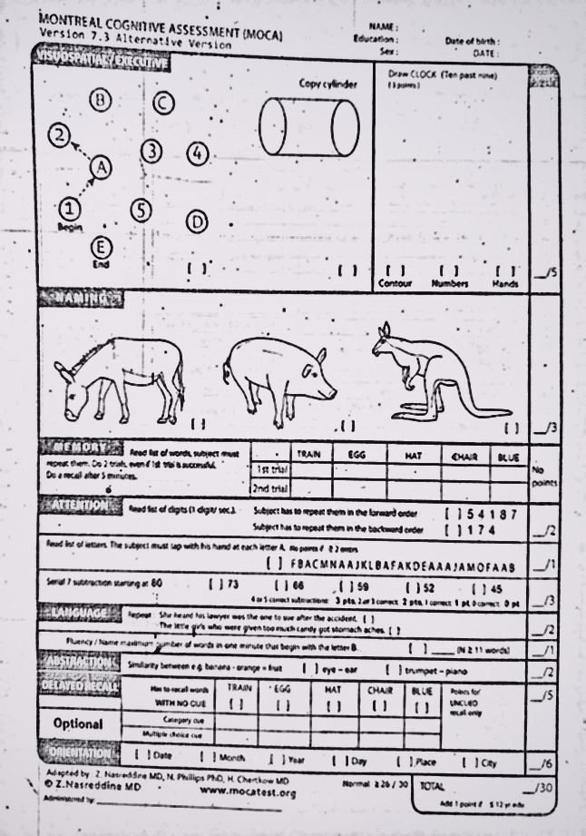
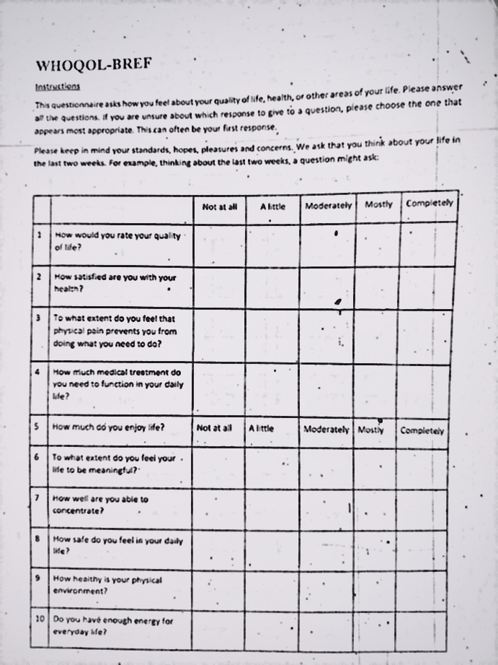
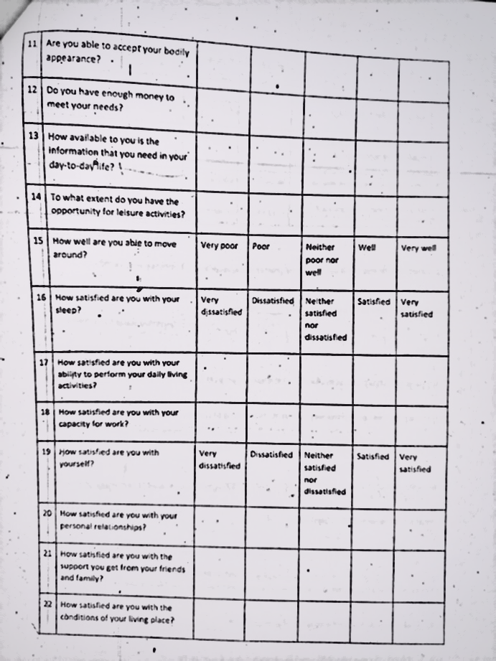
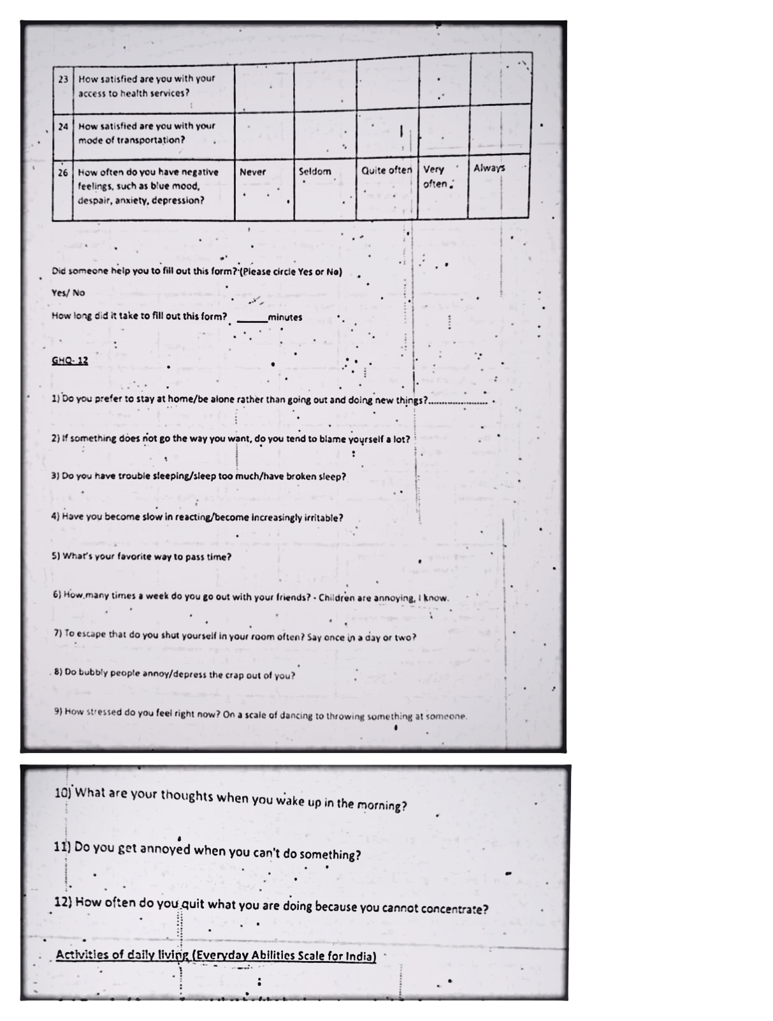
QUESTIONNAIRES
Figure 5 MOCA
Figure 6 WHOQOL-BREF
Figure 7 WHOQOL-BREF
Figure 8 GHQ

Slide 17
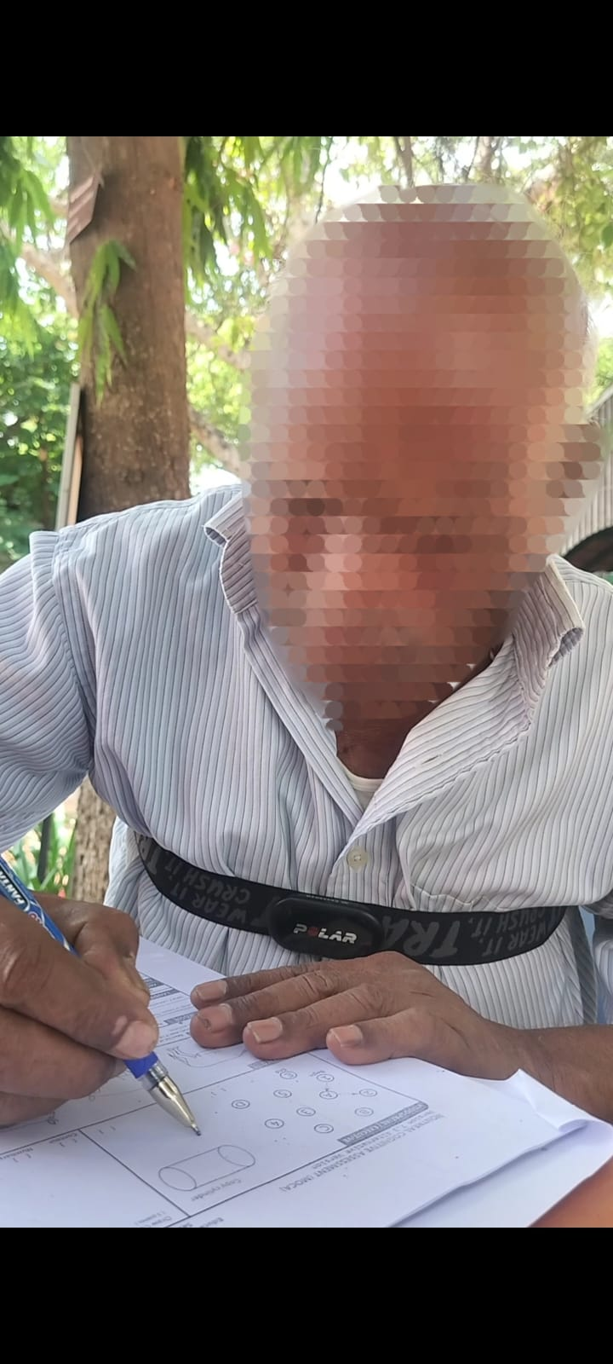
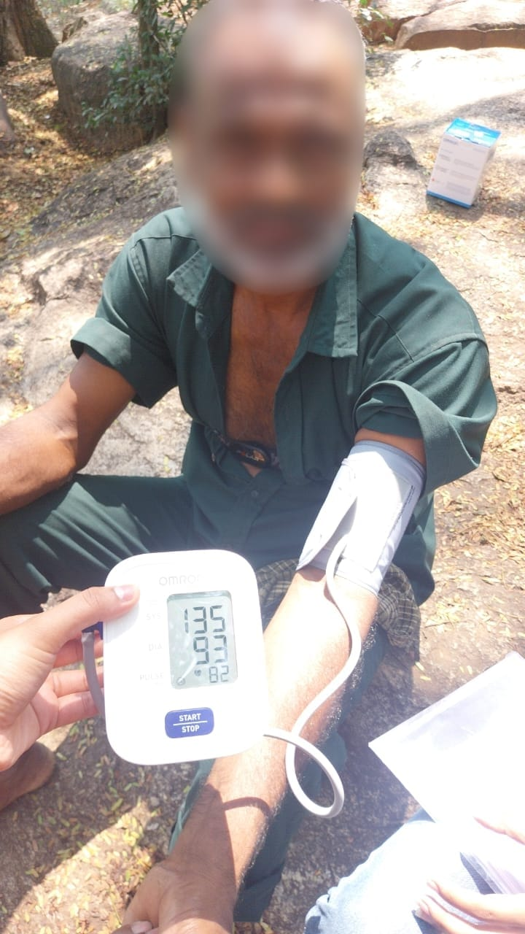
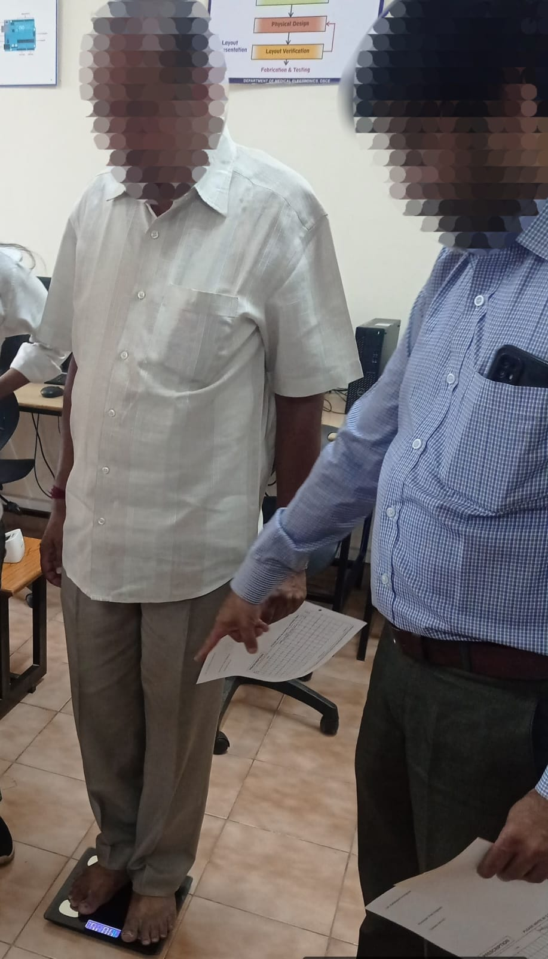

DATA COLLECTION
Figure 9 ECG
Figure 10 BP
Figure 11 Actofit
Figure 12 Video

Slide 18
PARAMETERS
PARAMETERS BEING MEASURED
Age | Bone Mass (kg)
Gender | Fat Mass (kg)
Systolic Blood Pressure (mmHg) | Metabolic Age (Yrs)
Diastolic Blood Pressure (mmHg) | Visceral Fat
Pulse Rate (bpm) | BMR (kcal)
Heart Rate (bpm) | Fat Free Weight (kg)
Weight (kg) | Body Fat (%)
Subcutaneous Fat (%) | Muscle Mass (kg)
Skeletal Muscle (%) | Protein (%)
BMI | Body Water (%)
PARAMETERS BEING CALCULATED
Mean Arterial Pressure (MAP) (mmHg)
MAP Score
Perfusion Index
Health Score
MOCA Score
WHOQOL-BREF Score
GHQ Score
Q Complex
R Complex
S Complex
Mean Arterial Pressure = Diastolic BP + 1/3 (Systolic BP – Diastolic BP)
Perfusion Index = (Mean Arterial Pressure/Heart Rate)*100

Slide 19
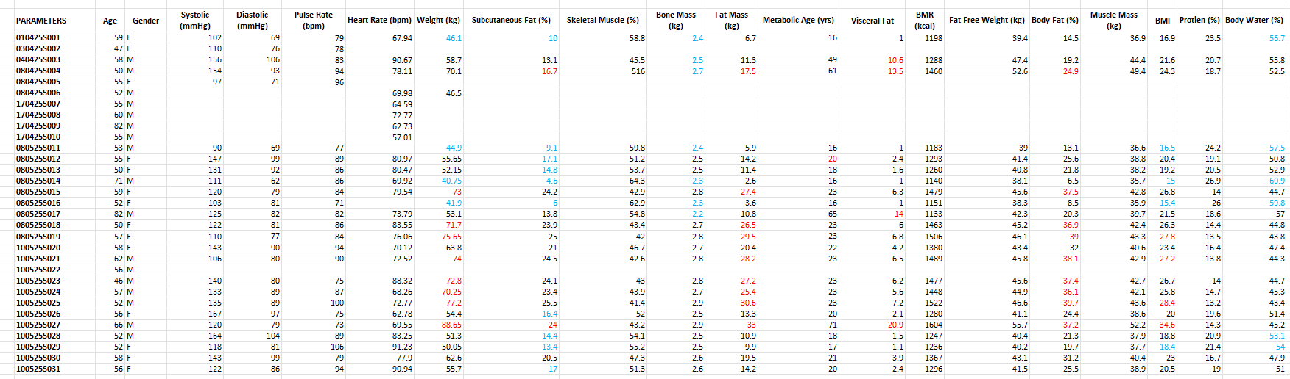
PARAMETERS DATA IN EXCEL

Slide 20
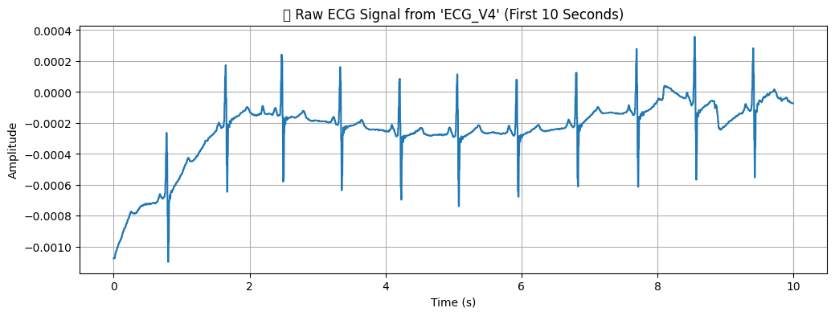
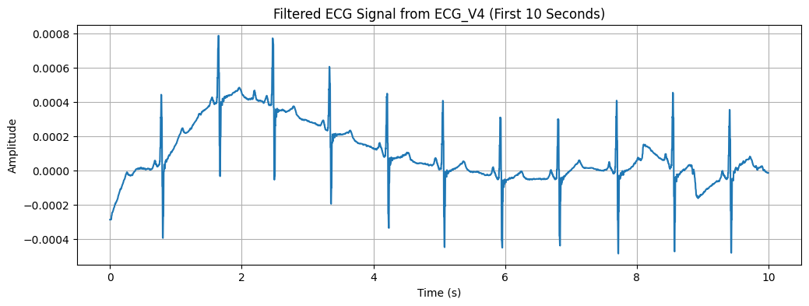

ECG EXTRACTION PROCESS
(mV)

Slide 21
FILTERS USED:
Bandpass Butterworth Filter
A bandpass Butterworth filter is used to allow only the ECG signal frequencies between a low cutoff (0.05 Hz) and high cutoff (125 Hz) to pass through, while attenuating frequencies outside this range, ensuring smooth signal preservation without sharp distortions.
High-Pass Filter (Lowcut = 0.05 Hz)
Removes very low-frequency noise, such as:
Baseline wander
Movement artifacts
Slow changes due to respiration
Allows frequencies above 0.05 Hz to pass.
Attenuates signals below 0.05 Hz, which are not useful for ECG interpretation.
Low-Pass Filter (Highcut = 125 Hz)
Removes high-frequency noise, such as:
Muscle contractions
Electrical interference
Power line noise
Allows frequencies below 125 Hz to pass.
Attenuates signals above 125 Hz, which are typically noise in ECG.
Bandpass Filter
Keeps only the useful ECG frequency band (0.05 Hz to 125 Hz)
Blocks noise from both low and high ends

Slide 22
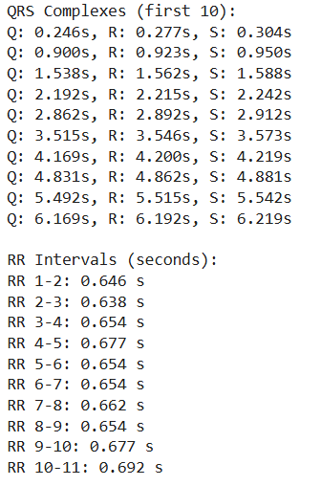
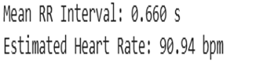
HEART RATE
RR Intervals:
Perfusion Index = (Mean Arterial Pressure/Heart Rate)*100

Slide 23
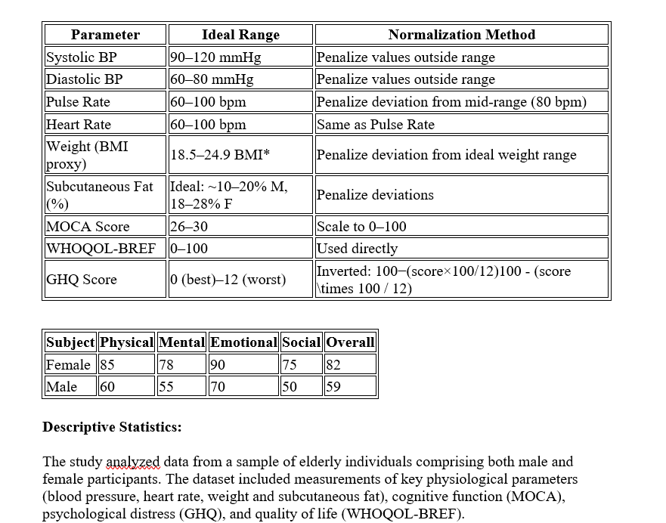
RESULTS
Descriptive Statistics:
The study analysed data from a sample of elderly individuals comprising both male and female participants. The dataset included measurements of key physiological parameters (blood pressure, heart rate, weight and subcutaneous fat), cognitive function (MOCA), psychological distress (GHQ), and quality of life (WHOQOL-BREF).

Slide 24
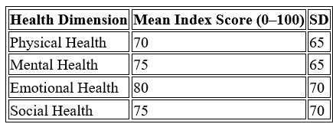
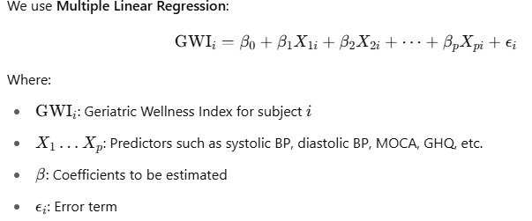
RESULTS
Health Dimension Indices
Each individual scores were normalized, and four distinct indices were computed using Interval-censored survival models ( Statistical Model) and Multi regression Model
Discussion: The findings of this study provide a multidimensional overview of geriatric health, using a novel composite metric Geriatric Wellness Index that integrates physical, mental, emotional, and social parameters.
Multiple Linear Regression
Example: GWI = β₀ + β₁*Systolic_BP + β₂*Diastolic_BP + β₃*Pulse_Rate + β₄*MOCA + β₅*GHQ + β₆*WHOQOL + β₇*Subcutaneous_Fat + ε

Slide 25
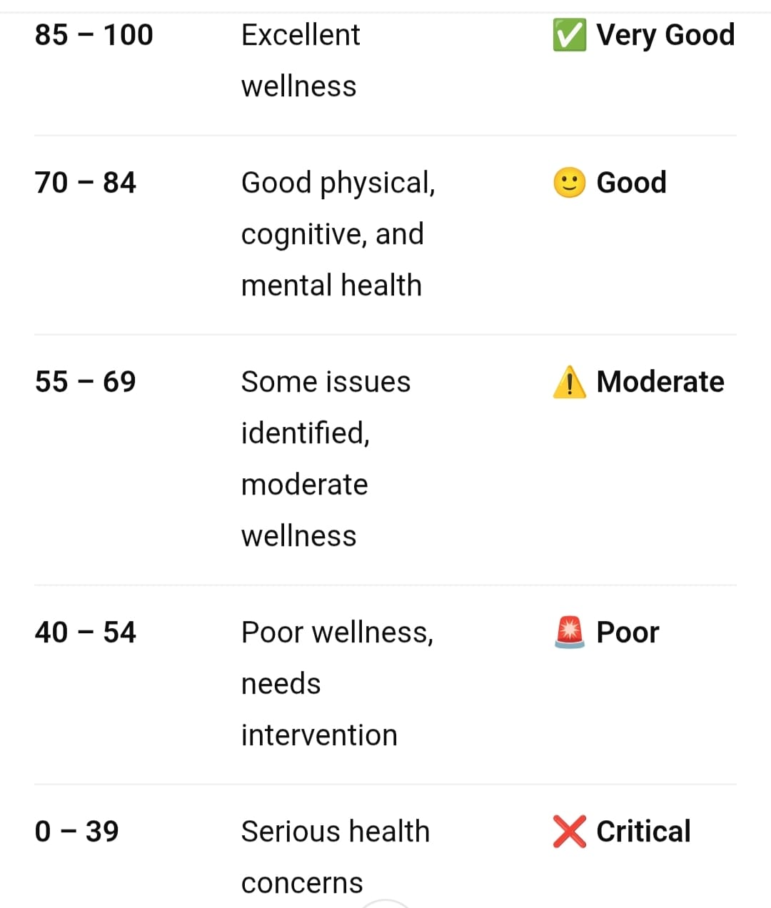
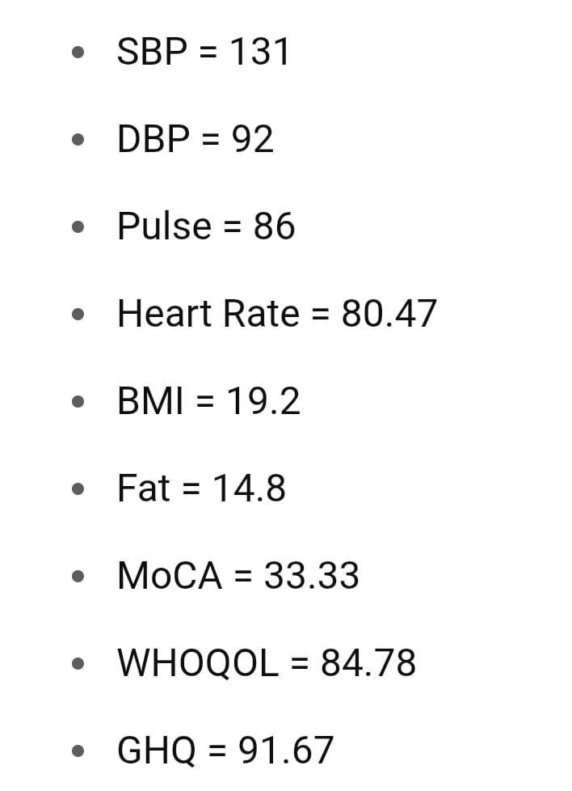
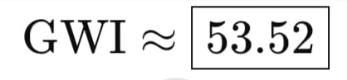
RESULTS
Parameters taken
GWI Calculation
GWI Ranges
Poor wellness, needs intervention

Slide 26
RESULTS
ID | SBP | DBP | PULSE | HR | BMI | FAT | MOCA | WHO-QOL | GHQ | GWI | WELLNESS LEVEL
1 | 131 | 92 | 86 | 80.5 | 19.2 | 14.8 | 33.3 | 84.8 | 91.7 | 53.52 | Moderate
2 | 125 | 88 | 78 | 75 | 22 | 16 | 45 | 80 | 85 | 61.15 | Moderate
3 | 140 | 90 | 70 | 74 | 24.5 | 20 | 50 | 90 | 95 | 69.13 | Good
4 | 120 | 85 | 85 | 80 | 26 | 22 | 30 | 70 | 80 | 48.55 | Poor
5 | 135 | 95 | 88 | 82 | 28 | 25 | 25 | 60 | 75 | 42.15 | Poor
6 | 118 | 78 | 65 | 70 | 21 | 15 | 60 | 88 | 98 | 75.37 | Good
7 | 145 | 100 | 90 | 85 | 30 | 28 | 20 | 55 | 60 | 36.02 | Poor
8 | 128 | 86 | 72 | 73 | 23.5 | 18 | 40 | 78 | 88 | 59.57 | Moderate
9 | 138 | 89 | 74 | 76 | 25 | 21 | 38 | 82 | 85 | 61.67 | Moderate
10 | 115 | 80 | 68 | 68 | 20.5 | 14 | 55 | 90 | 95 | 74.83 | Good
ID 3, 6 & 10 – Good: Healthy and well.
IDs 4, 5, 7 – Poor: Need attention — mainly cognitive, metabolic, or cardiovascular interventions.
IDs 1,2, 8, - Moderate: Monitor- may need lifestyle adjustments or preventive care.

Slide 27
CONCLUSION
This project represents a significant step toward advancing elderly care through the combination of wearable technology and cognitive assessments.
By utilizing the Geriatric Wellness Index (GWI), we aim to create a more comprehensive and effective system for monitoring elderly health, enabling healthcare professionals to better identify those at risk for cognitive decline.
Ultimately, our project seeks to enhance the quality of life for older adults while supporting clinicians in providing more targeted and efficient care.

Slide 28
REFERENCES
Zhihong Li, "The situation of actively coping with population aging in the 14th Five-Year Plan Period and the national strategic countermeasures [J]", Scientific Research on Aging, no. 8, pp. 3-21, 2020.
Jianhui Zhang and Liping Mao, "Design development and realization of big data smart elderly care platform[J]", Public Communication of Science & Technology, vol. 14, no. 21, pp. 131-134, 2022.
Liang-Kung Chen: "The health challenges of aging society", Taipei Veterans General Hospital Magazine, Vol.144, pp. 2-8, 2009.
Dowliing A.F.JR.: "Do hospital staff interfere with computer system implementation?", HealthCare Manage Review, Vol.5, pp.23-32, 1980.
Haynes B. Can it work? Does it work? Is it worth it?: the testing of health care interventions is evolving. BMJ. Br Med J. 1999;319:652
Say RE, Thomson R. The importance of patient preferences in treatment decisions—challenges for doctors. Bmj. 2003;327:542–5.
DEPARTMENT OF MEDICAL ELECTRONICS ENGINEERING, DAYANANDA SAGAR COLLEGE OF ENGINEERING

Slide 29
THANK YOU

